Slide 1

Introduction to Business Analytics
Final Project
Insurance Charges Analysis and Model Evaluation
Hiral Shah - 101539997
Rajesh Adep - 101540051
Shakshi Maheshwari - 101539638
Manushka Mhatre - 101543219

Slide 2
Introduction
Objective: Explore relationships between demographic factors and insurance charges
Goal: Build a predictive model for insurance charges using key features.
Sections Covered:
Exploratory Data Analysis (EDA)
Data Visualizations and Insights
Linear Regression Analysis
Conclusions and Recommendations

Slide 3

Exploratory Data Analysis (EDA)
Dataset Overview
1337 records after removing 1 duplicate.
7 columns: age, sex, BMI, children, smoker, region, and charges.
Key Statistics
Average age: 39.22 years
Average BMI: 30.66 (overweight/obese)
Average charges: $13,279.12
Outlier Detection
BMI: 9 outliers
Charges: 139 outliers

Slide 4
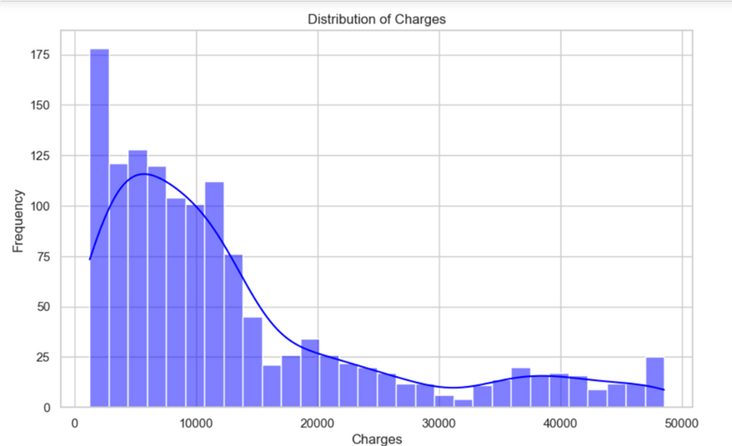
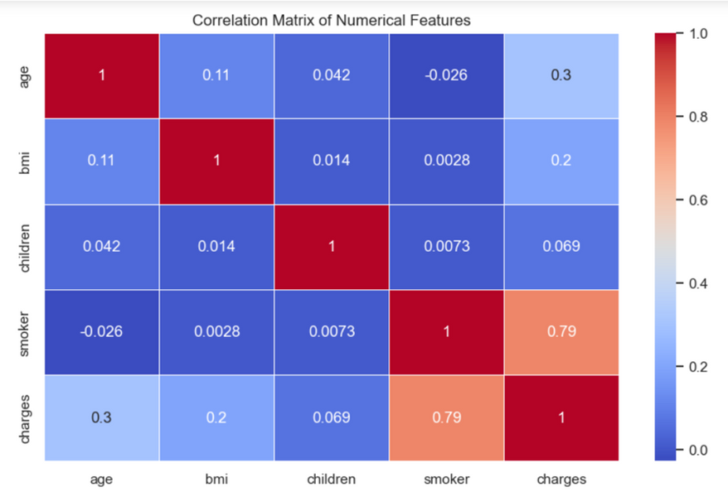
Data Visualizations & Insights
Distribution of Charges: Right-skewed: Most individuals have lower charges, with a few high-cost outliers.
Correlation Matrix:
Smoking has the highest correlation with charges (0.79).
Age and BMI show moderate positive correlations with charges.

Slide 5
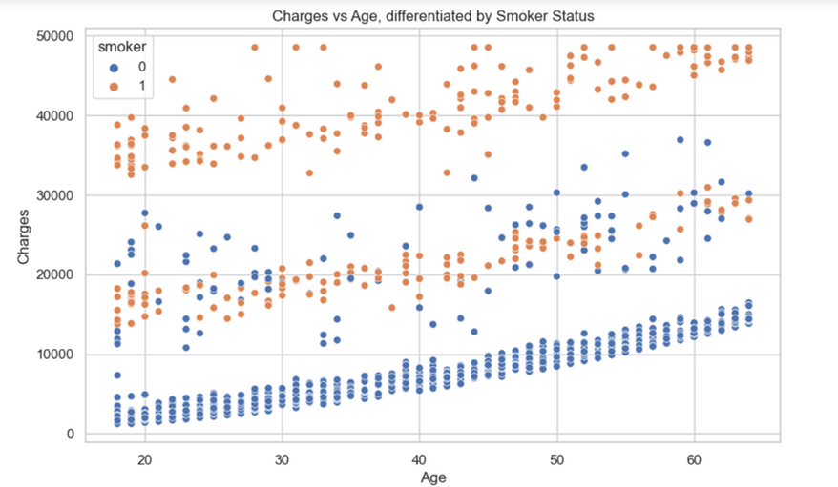
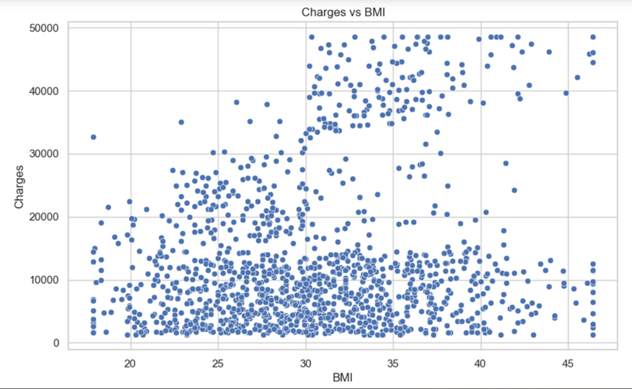
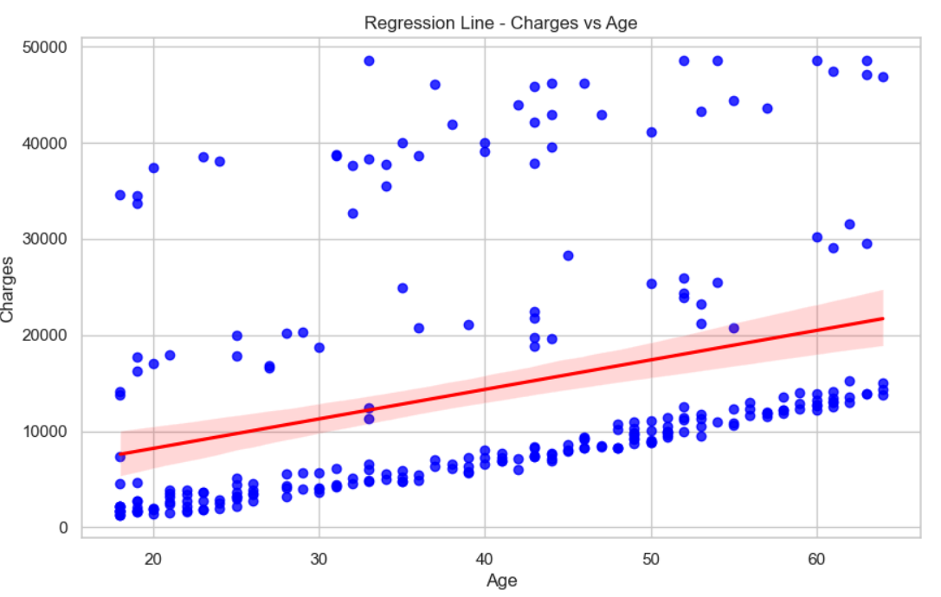
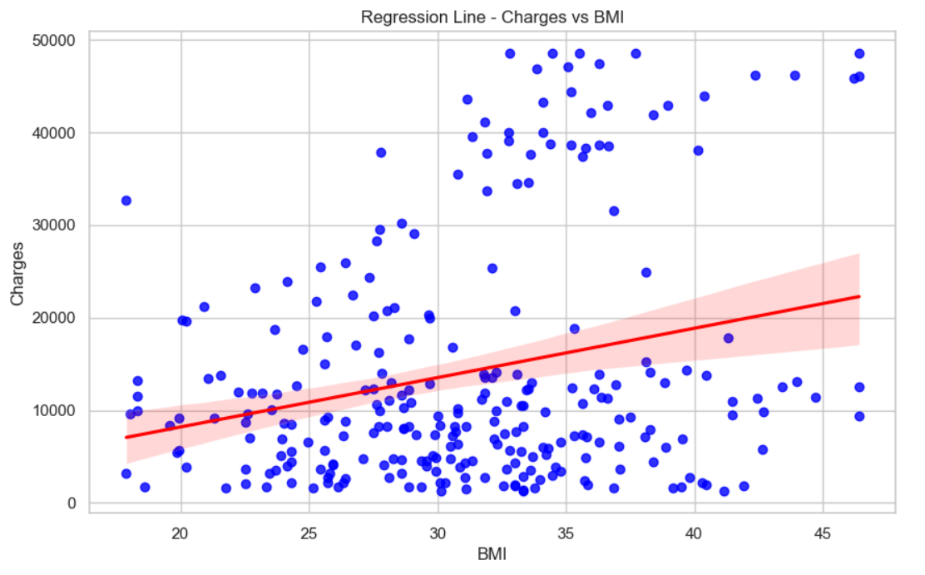
Scatter Plots and Key Relationship
Charges vs Age (Smokers vs Non-Smokers): Smokers have significantly higher charges, especially as age increases.
Charges vs BMI: Higher BMI is associated with higher charges, but the relationship is weaker.

Slide 6
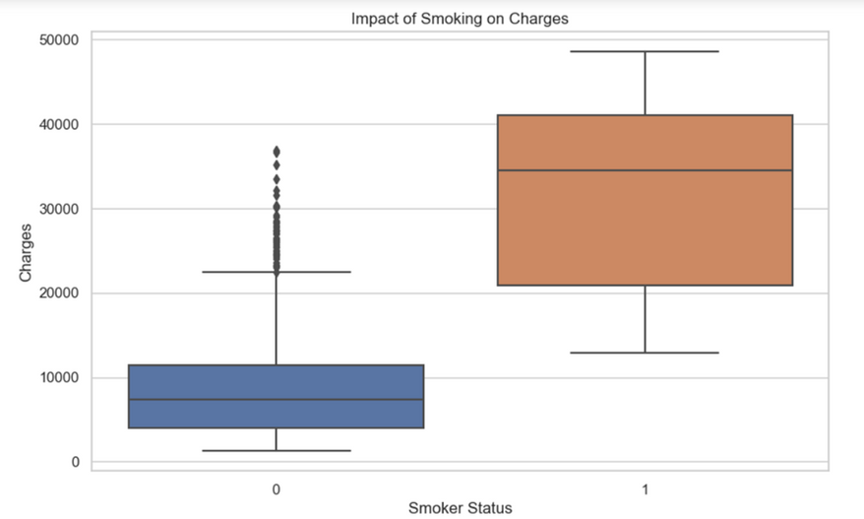
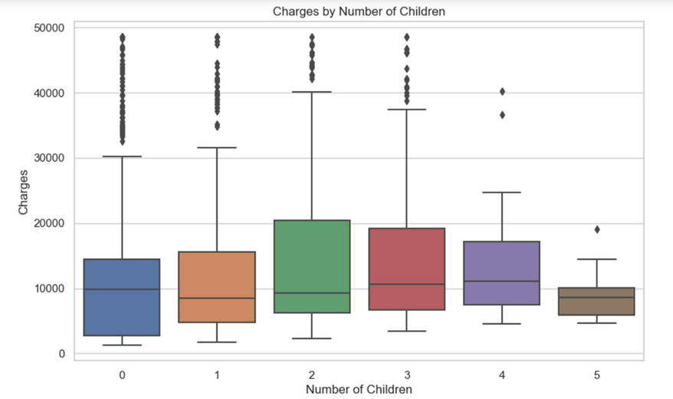
Additional Visual Insights
Impact of Smoking: Smokers incur significantly higher charges than non-smokers.
Impact of number of Children: Number of children does not have a significant impact on charges, as median values are similar and close across different groups.

Slide 7
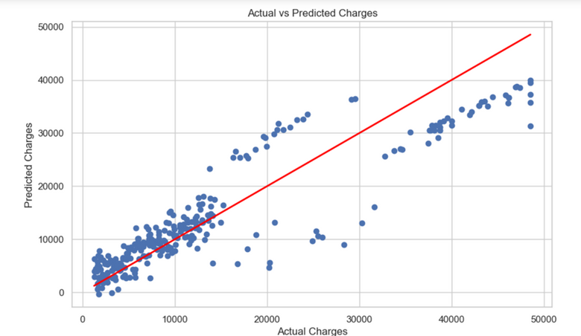
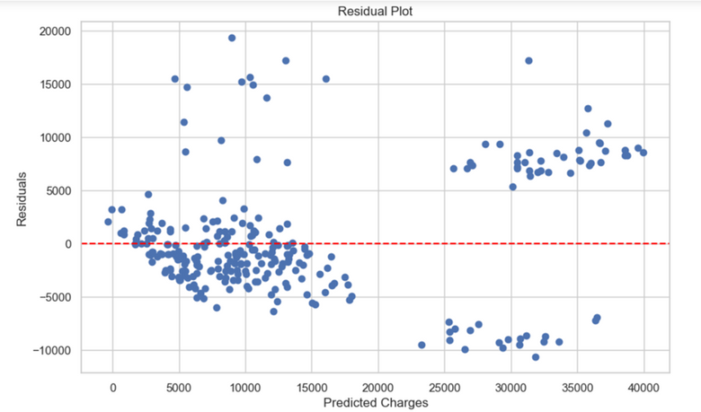
Linear Regression Model
Features Used - Age, BMI, Smoker
Dataset Split - 80 Training:20 Testing
Coefficients
Age: +$251 per year
BMI: +$307 per BMI unit
Smoking: +$22,941 for smokers
Intercept - (-$10,825.66)
R-squared value
0.8191 (explains 82% of variance in charges)
Model Performance Evaluation
Good Fit: R-squared value of 0.8191 shows the model explains most of the variance.
Residual Analysis: Most Random residual scatter near 0 indicates no major bias in predictions.
Actual vs Predicted Charges: Predicted values closely follow actual charges, but some high-end deviations exist.

Slide 8
Recommendations for Improvement
Feature Engineering:
Include additional variables like region and interaction terms (e.g., smoker status with BMI).
Non-Linear Models:
Explore decision trees or polynomial regression for non-linear relationships.
Outlier Handling:
Consider robust regression techniques to better manage outliers.

Slide 9
Conclusion
Key Takeaways:
Smoking has the largest impact on medical charges.
BMI and age are moderate predictors of charges.
Model Performance:
Linear regression performs well, explaining 81.91% of the variance.

Slide 10
Thank you

